Slide 1
Corrections
Series of Programs
Management of Offenders
Primary Means of Formal Control Current Political/Social Landscape

Slide 2
Corrections as a Series of Programs
How many corrections programs/places can you name?

Slide 3
What does corrections do?
Management of offenders
People skills valued
Carrying out the sentence
Exceptions to this?

Slide 4
The Incarceration “Binge”

Slide 5
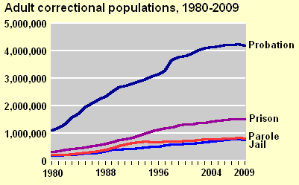
Its not just prisons and jails

Slide 6
Overall trends hide some variation
Race
White incarceration rate = 410/100,000
Black = 3,200/100,000
Hispanic = 1,200/100,000
State variation
“Big 4” states house 40% of nations inmates
Why does MN have 10,000 inmates and WI 25,000?

Slide 7
Corrections as part of “system”
Other CJ agencies affect corrections:
Legislature
Police
Courts
HOWEVER → sometimes little communication or feedback
Not really a single system
51 different systems (at a minimum) in the U.S.

Slide 8
The Correctional System
One component of corrections can have an impact on other components
Examples from the 1980s and 1990s
Prison crowding
Probation and parole supervision strategy

Slide 9
Issues in Corrections
History
Goals/rationale for corrections
Politics and ideology
Performance/effectiveness
Past 15 years = push to “evidence-based”
Management
How much to PO’s, CO’s, Wardens matter?

Slide 10
Current Correctional Climate
Political
Corrections used to be “left to the experts”
Attack on rehabilitation in the 1970s
Voting on sentencing structures and practices
California “propositions”
Public
Prisons from strange places out in the “sticks” to…
Fodder for entertainment and news television

Slide 11
Groups
Assume the state of Minnesota mandates the closing of all prisons.
What would you do with serious criminal offenders?

